Slide 1
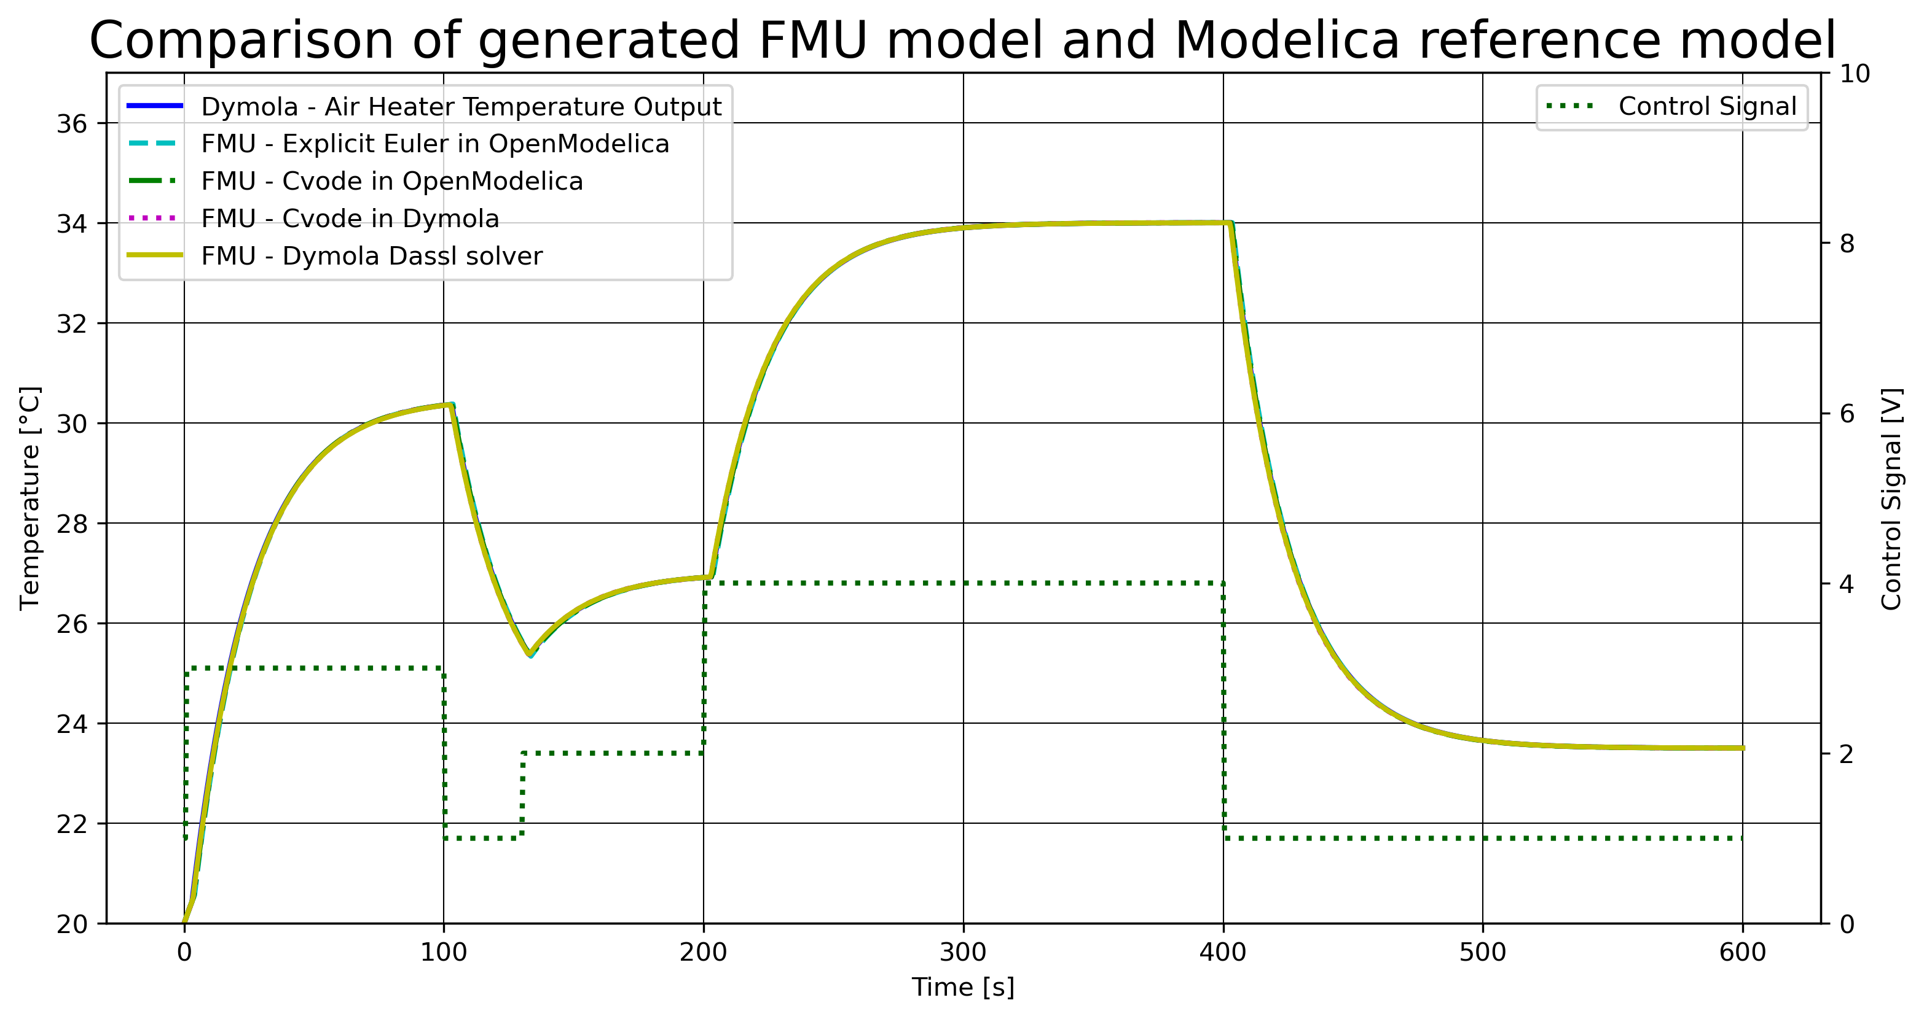
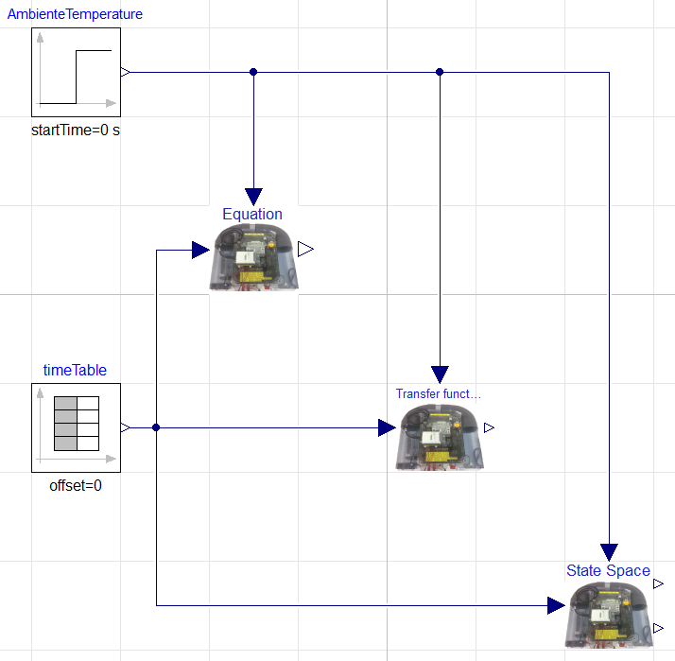
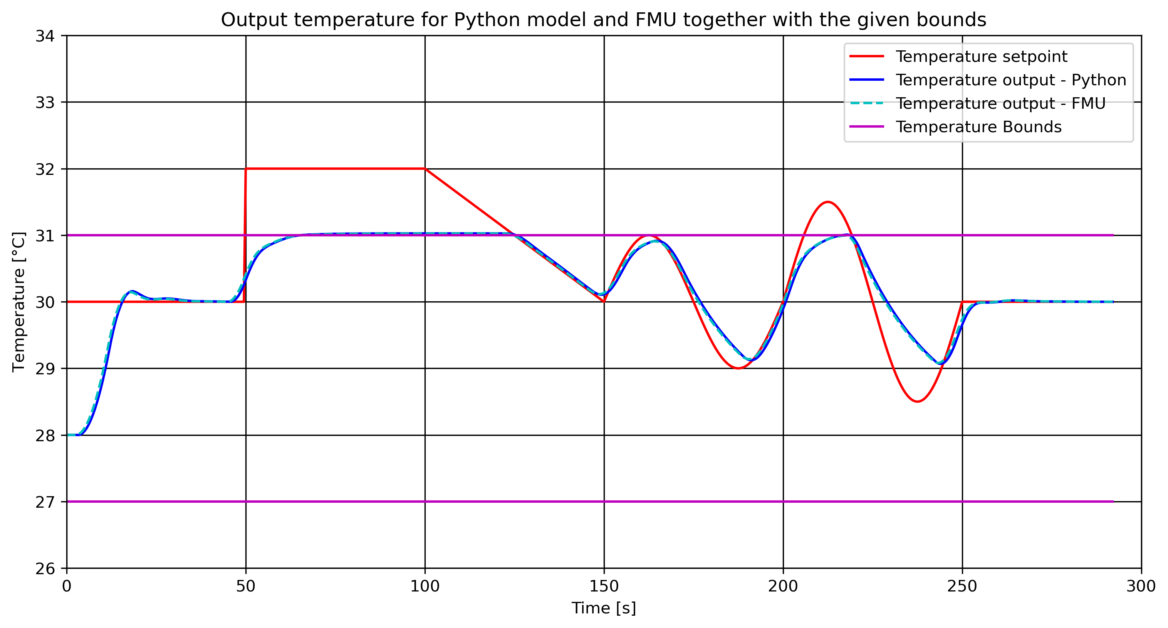
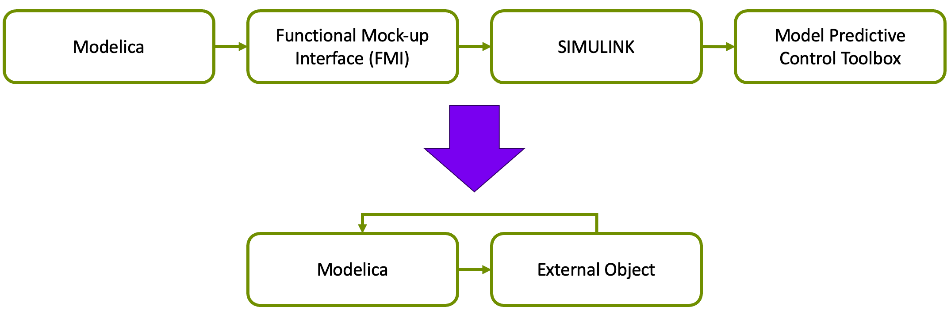
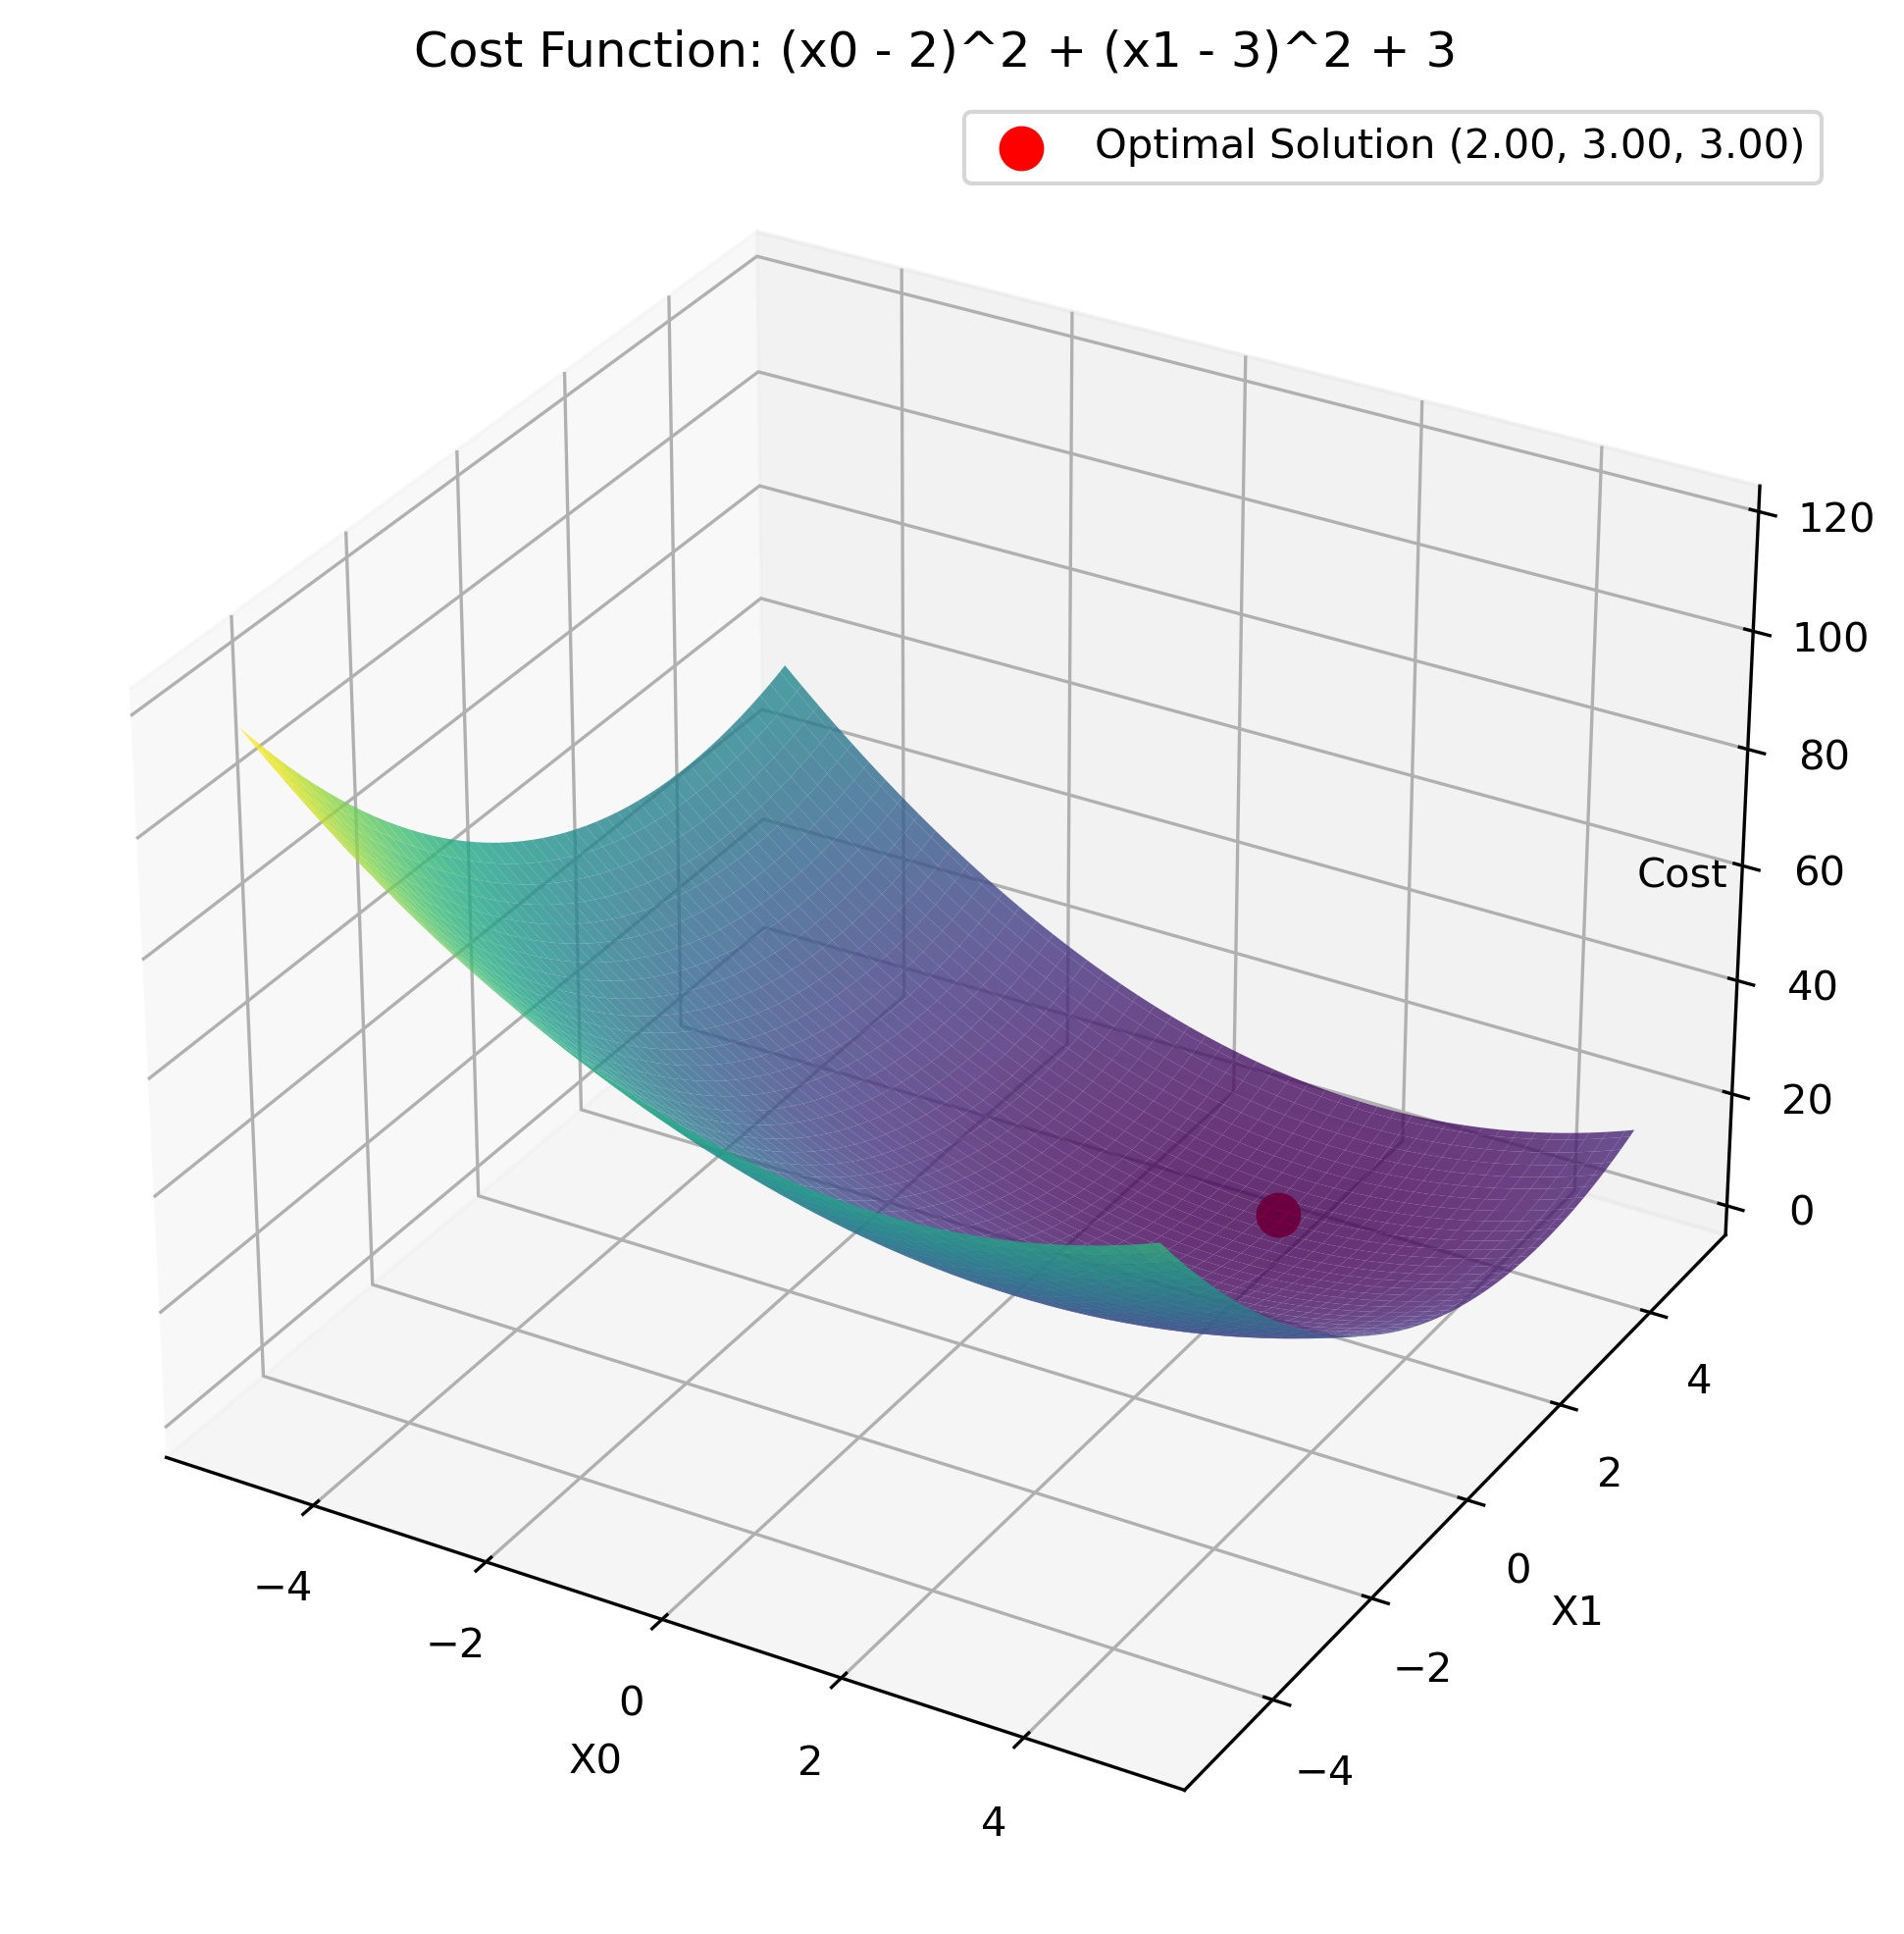
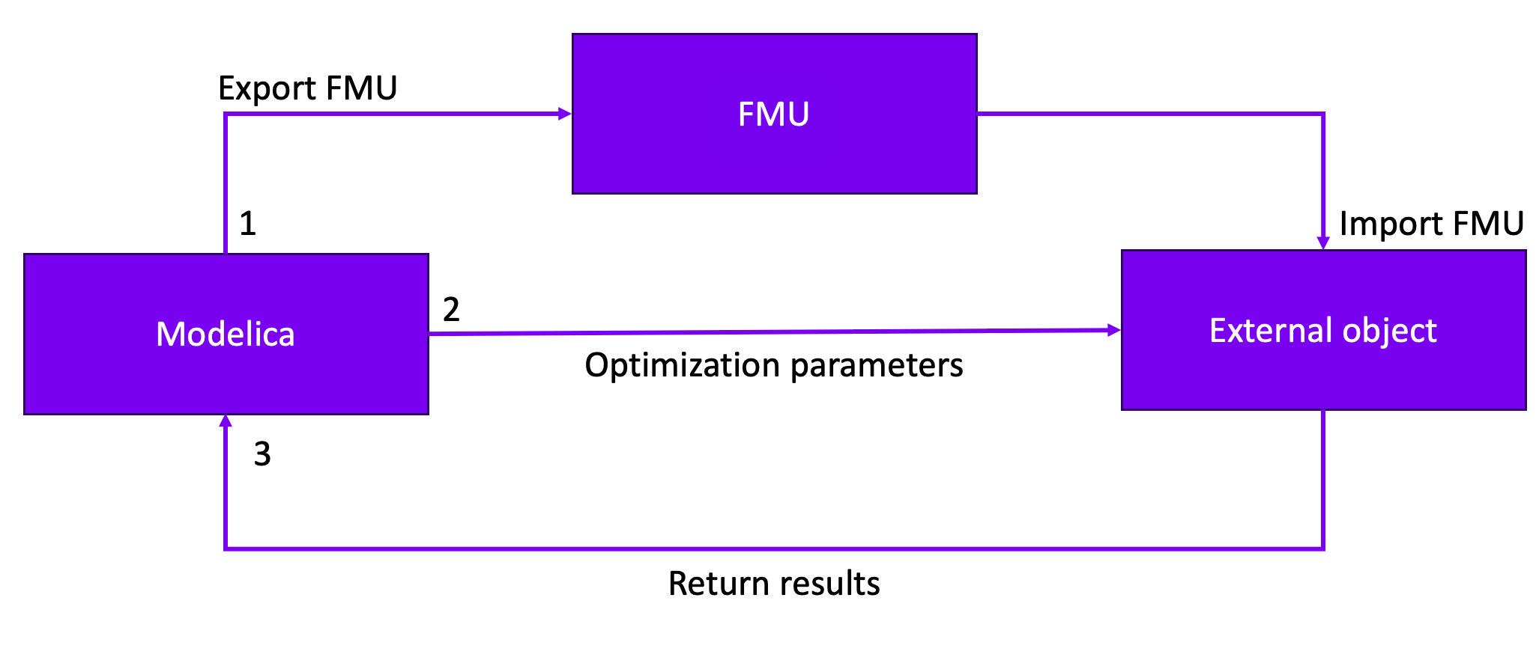

﻿Master’s Thesis 2023
Advanced control implementations with Modelica
Carl Magnus Bøe MSc Industrial IT and Automation
1. Introduction
3. Model of Air Heater
5. Results of Air Heater FMU and MPC in Python
In the absence of inherent support for advanced control methods in Modelica, the current workflow as displayed in Figure 1, consisting of generating models within Modelica. Subsequently, the models are exported as functional mock-up units (FMUs) to SIMULINK. Within SIMULINK the MPC block in the model predictive control toolbox is utilized to compute the control signal.
Three models of the air heater was implemented in OpenModelica. The models is based on first-principles, transfer function and state space models as displayed in the OpenModelica implementation displayed in Figure 3.
Both a first-principles model and an FMU of the air heater was simulated together in a Python script. The resulting plot is presented in Figure 5. The source code utilizes the models to perform a MPC simulation and compares the results for both simulations.
Figure 1: Current workflow
Figure 3: Implemented models in OpenModelica
Figure 5: MPC simulation results
2. Problem Description and Objective
4. Calling External C code in Modelica
6. Conclusion
Yara's goal is to enhance efficiency by centralizing the entire system within Modelica. An option under consideration involves the integration of an MPC block directly into the Modelica environment with the use of external objects as displayed in Figure 2.
The Modelica external object class was utilized to allocate space in memory to store variables, and to perform a function call of an external C function performing an optimization and returning the results back to the Modelica environment. The optimization was performed with the NLopt library for C based on the the cost function given in Figure 4.
﻿this thesis provides insights into advanced control implementation strategies within the Modelica framework and serves as a practical user manual. The comprehensive explanations provided are intended to assist in the implementation of these control strategies together with the associated GitHub repository.
Future work is presented in Figure 6.
Figure 2: Future workflow
Figure 4: Optimization
Figure 6: Future work
﻿Faculty of Technology, Natural Sciences and Maritime Sciences
GitHub: https://github.com/cmbNor/Advanced-Control-Implementation-with-Modelica
Campus Porsgrunn

